Slide 1
Integrated Virtual Health Solutions – Customer Service
Notes:
What is MDLIVE?
With MDLIVE, you can access a board-certified doctor via secure online video, phone or the MDLIVE App – anytime,
anywhere, 24/7/365. MDLIVE was designed as an alternative to expensive urgent care visits or waiting days to get an
appointment with your primary care doctor for non-emergency medical conditions. Our doctors can diagnose your
symptoms, prescribe non-narcotic medication (if needed), and send e-prescriptions to your pharmacy of choice.+

Slide 2
Registering Members

Slide 3
How do I sign up for MDLIVE or Activate my MDLIVE Account?
You can easily sign up or activate your account by using one of the following methods:
1. Visit mdlive.com/SISC and click “Activate Now”
2. Just call us at 1-800-657-6169
3. Download the MDLIVE App, available for iPhone, Android, and Windows smartphones.
4. Text Sophie:
Take out your mobile device
Next, open your text messaging app and compose a new text message
In the ‘To’ field enter: 635483
Type the word ‘sisc’ in message field and click send

Slide 4
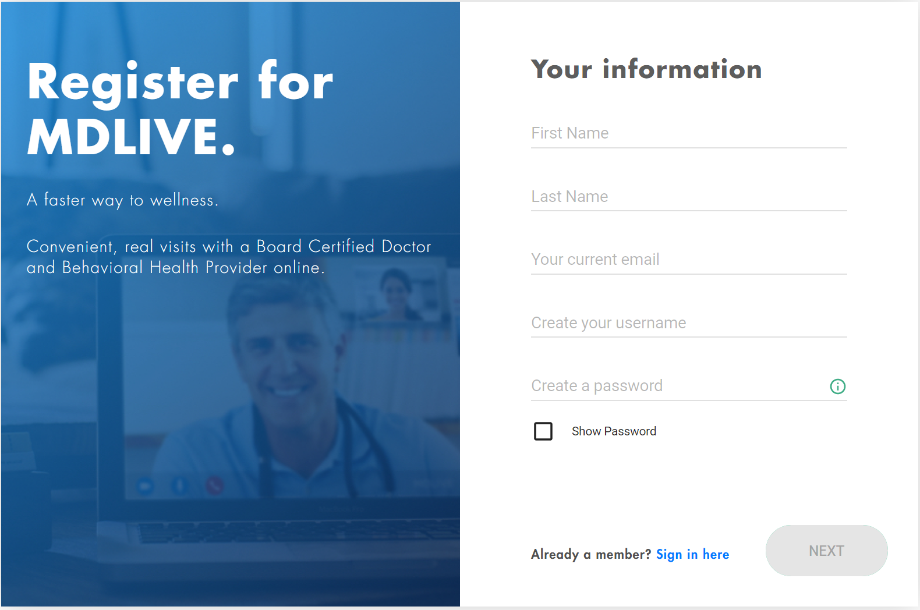
New Member Registration
Our new redesigned registration form provides a simpler and more efficient way for customers to create an account.
With less required fields and a new progressive profile system, we were able to reduce and simplify the amount of information required to onboard both retail and enterprise customers

Slide 5
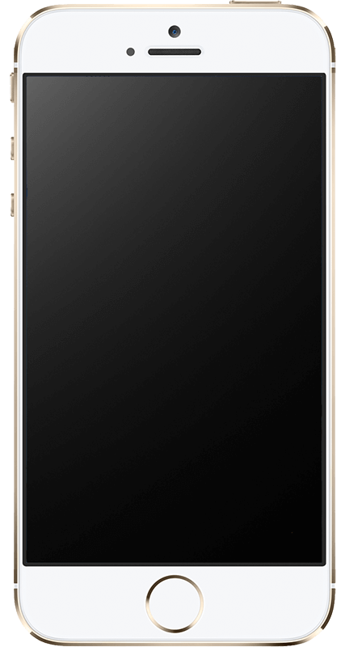
EXPERIENCE SOPHIE
1. Please take out your mobile device
2. Next, open your text messaging app and compose a new text message
3. In the ‘To’ field enter: 635483
4. Type the word ‘sisc’ in message field and click send

