Slide 1
Governor’s FY 2024-25 Proposed Budget
Board of Trustees Meeting
January 16, 2024
Iris Ingram, Vice Chancellor, Business Services

Slide 2
Legislative Analyst Office Version
State facing a $68B deficit
Prior year revenue shortfall in 2022-23 ($26B below estimate)
Delayed tax deadlines (April to November) pushed news of revenue shortfall to after close of fiscal year 22-23
Weather-related (wild fires and floods) losses to state businesses and residents
Inflation reduced State’s spending power through increased cost of borrowing (interest rates)
Reduced economic activity
Home sales
Business start ups
IPOs
Increase in unemployment rate
Tools to address budget gap
Use of reserves ($24B)
Spending reductions likely
to education ($17B)
one time expenditure cuts ($10B)
Cost shifts between fiscal years
Relatively few options
Use of reserves
Not sufficient to cover multi-year deficits ($30B per year)
Cost shifting among fiscal years
Use of one-time dollars

Slide 3
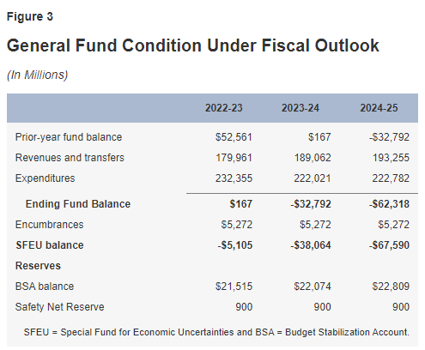
Legislative Analyst’s Projections

Slide 4
Options for Budget Deficits
Draw down Reserves
$24B available
Requires declaration of a “budget emergency”
Reduce Prop 98 spending
Cuts to K-14
Reduce other One-time Spending
Source: LAO, The 2024-25 Budget, California’s Fiscal Outlook

Slide 5
Governor’s 2024-25 Budget Proposal
Presented a balanced budget of $291.5B
General Fund budget of $208.7B
Budget shortfall of $37.86B
Continues the following priorities “Promises Kept”
$15.3B for Homelessness Programs
$8.7B for Mental Health Programs
$1.1B (over 4 years) for Public Safety
$109.1B (Prop 98) for Career Education
UC system - $273.3M
CSU system - $240.2M
$58B for Climate Initiatives

Slide 6
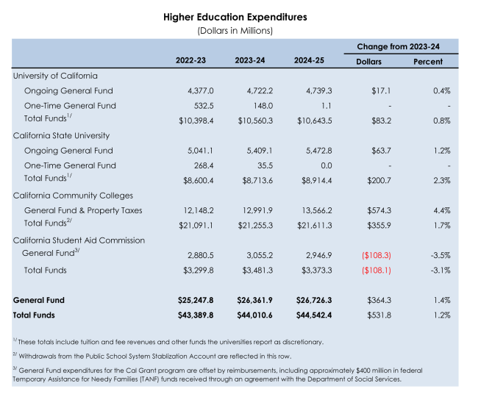
Proposal for Higher Education
Source: 2024-25 Governor’s Budget Summary

Slide 7
Community College Proposal
Continued focus on the multi-year roadmap
Equity
Student success
Preparing students for the future
COLA of 0.76% to SCFF or $69.1M
Growth of 0.5% or $29.6M
Select Categorical programs and Adult Education will receive a COLA of $9.3M or 0.76%
Drawdown from Reserves (School Rainy Day Fund) of $235.9M in 2023-24 and $486.2M in 2024-25 to support the SCFF.
Increase of $60M one-time Prop 98 funds to expand nursing programs
Continues support for Student Housing through Lease Revenue Bonds, but pulls back $300M in one-time General Fund appropriations for 2024-25 to 2028-29

Slide 8
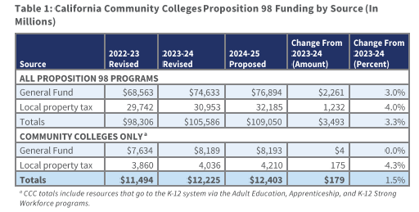
Comparison of Funding to the System
Estimates of Prop 98 funding minimum guarantee for FY22-23 and FY23-24 have decreased compared to FY23-24 budget
Revised estimates are considerable lower due to weaker revenues
Equals a reduction of >$11B over three (3) budget years
Source: Joint Analysis, Governor’s January Budget, January 10, 2024

Slide 9
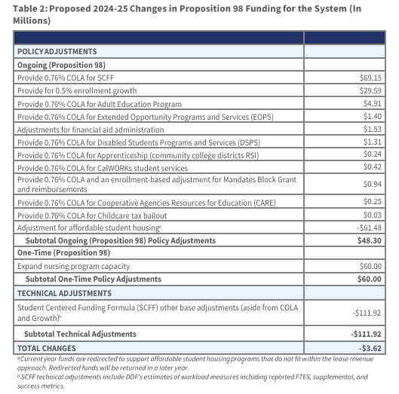
Proposed Changes to Prop 98 Systemwide Funding

Slide 10
What’s Next?
Hearings and meetings in February – March
Senate Budget Subcommittee
Assembly Budget Subcommittee
May Revise
June 10, 2024 -Tentative Budget approval by RSCCD Board of Trustees
June 17, 2024 - deadline for Legislature to approve State Budget

