Slide 1




Technology Decision-Making
Presented by Cambridge West Partnership, LLC
Notes:
Thank you for the opportunity to speak with you today!
I am here to talk about decision making regarding technology-in industry this is termed IT or Technology Governance not to be confused with participatory governance.
Explain about myself and my firm
I have been working with ITS to look at the decision making structures in the District for technology with an eye towards:
Streamlining communications
Transparency
Meeting Accreditation standards

Slide 2
Agenda
Welcome and Introductions
Definition of IT/Technology Governance
Types of Decision-making Groups
Planning/Policy and Operations
Current Decision-making Structure for Technology
Issues to be Addressed
Role of this Committee
Bringing it All Together!
Questions and Discussion
Notes:
Review the agenda. Brief introductions. Note here that this is the work of CWP based on our observations and expertise.

Slide 3
Gartner Group Definition of IT Governance
According the Gartner Research IT governance is “one of the most critical leadership disciplines required to enable organizations to execute on their operational and strategic goals”. In addition, Gartner notes that IT governance does two things including:
  Guides stakeholders in decision making to ensure the organization accomplishes their business outcomes (external governance or policy & planning), and
  Determines how those goals and objectives are accomplished (internal governance or operations).
Gartner also notes the following important key concepts that make IT Governance successful:
  Design of the right IT governance structure which works within the institutions culture, and
  Implementation of the structure to operate IT governance as a recognized enterprise process for decision-making.

Slide 4
Types of Decision Making Groups
Governance Groups
  Authority from law and regulation
  Constituency based representation – act as liaison to whom the represent and report out
  Makes recommendations to the Chancellor
  Focus on Policy & Planning – “What”
  Monitors progress over time
  Examples at District: District Council, Technology Advisory Group
  Examples at Campus: Academic Senates
Notes:
There are three types of decision-making groups in the Community College setting. There are Governance Groups, Operational Groups and Ad Hoc Groups.
Describe here the Governance Group.

Slide 5
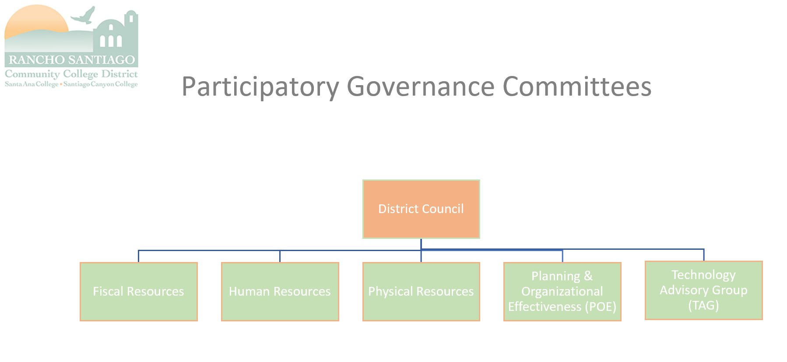
Notes:
Rancho Santiago current Governance Groups at the District level. There are also college-based governance groups.

Slide 6
Types of Decision Making Groups
Operational Groups
  Authority derived from the Board and Chancellor
  Subject matter experts determined by job in the District
  Assists the Chancellor in implementing the plans and policies by coordinating operational, procedural and policy implementation
  Focus on Operational Execution – “How”
  Monitors completion
  Examples at District: Chancellor’s Cabinet
  Examples at Campus: Presidents Cabinet
Notes:
Second type of group is the Operational Groups. Describe the Operational Group characteristics.

Slide 7
Types of Decision Making Groups
Ad Hoc Work Groups
  Authority from appointing authority
  Limited in time and scope
  Disbanded when work completed
  Example: Hiring committee
Notes:
Third type of group is Ad Hoc. Describe the characteristics.

Slide 8
Separation of Planning/Policy and Operations
Decision-making for both policy/planning and operations is too much work for one group to accomplish
Gartner recommends separation of these activities for best results
Policy/Planning decisions should be made by constituents; daily operational decisions should be made by practitioners and end users who are most affected by the decision and who have the most knowledge about the impacts of the decisions
Provides an avenue for those affected by operational decisions to have direct input
Notes:
Decision making is of two types Planning & Policy; and Operations. Use the example of the Board of Governors and RSCCD Board of Trustees to describe the differences.

Slide 9
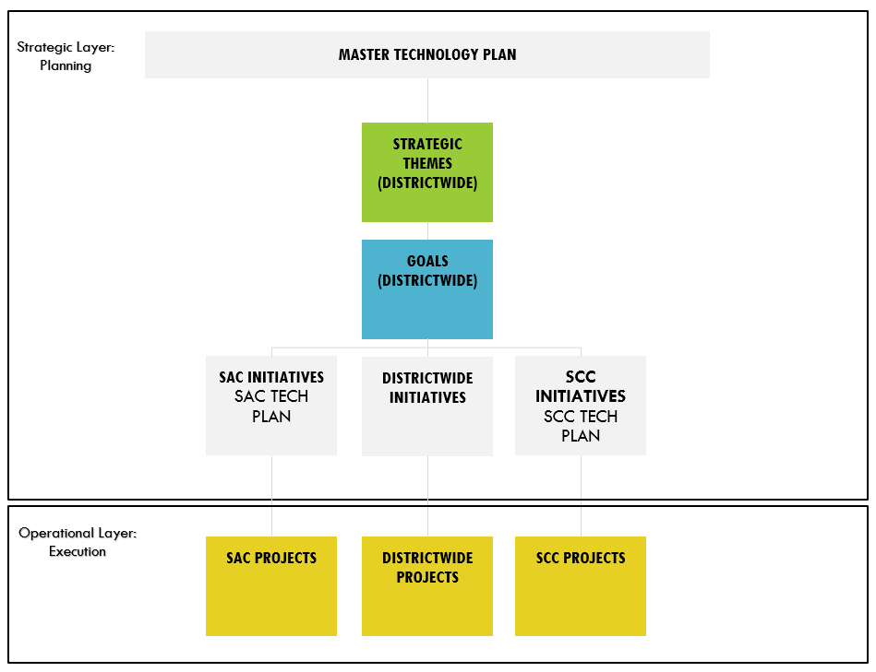
Example: Structure to be Used for RSCCD Master Technology Plan
Notes:
This separation of roles and responsibilities is evident in the new Master Technology Plan.
You approved this document.

Slide 10
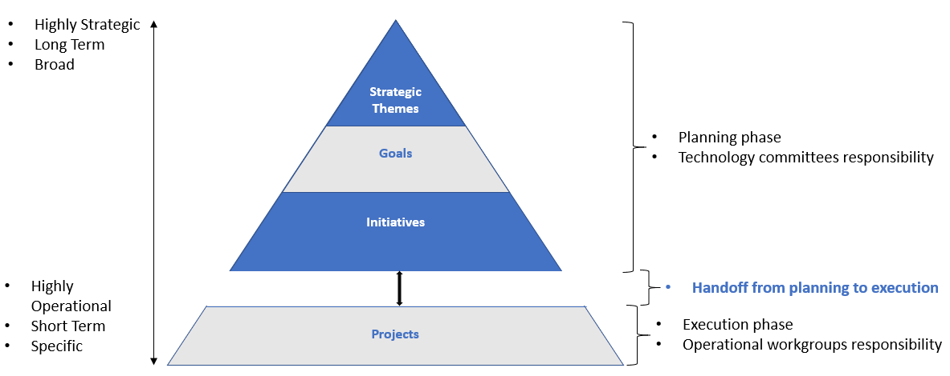
Example: Areas of Responsibility for RSCCD Master Technology Plan
Notes:
Describe the roles and responsibilities in the new Master Technology Plan. Notice the double-headed arrows because communications continues both ways. Example you are the monitors of the progress on the Technology Plan and an operational group would be executing the work.
You approved this document.

Slide 11
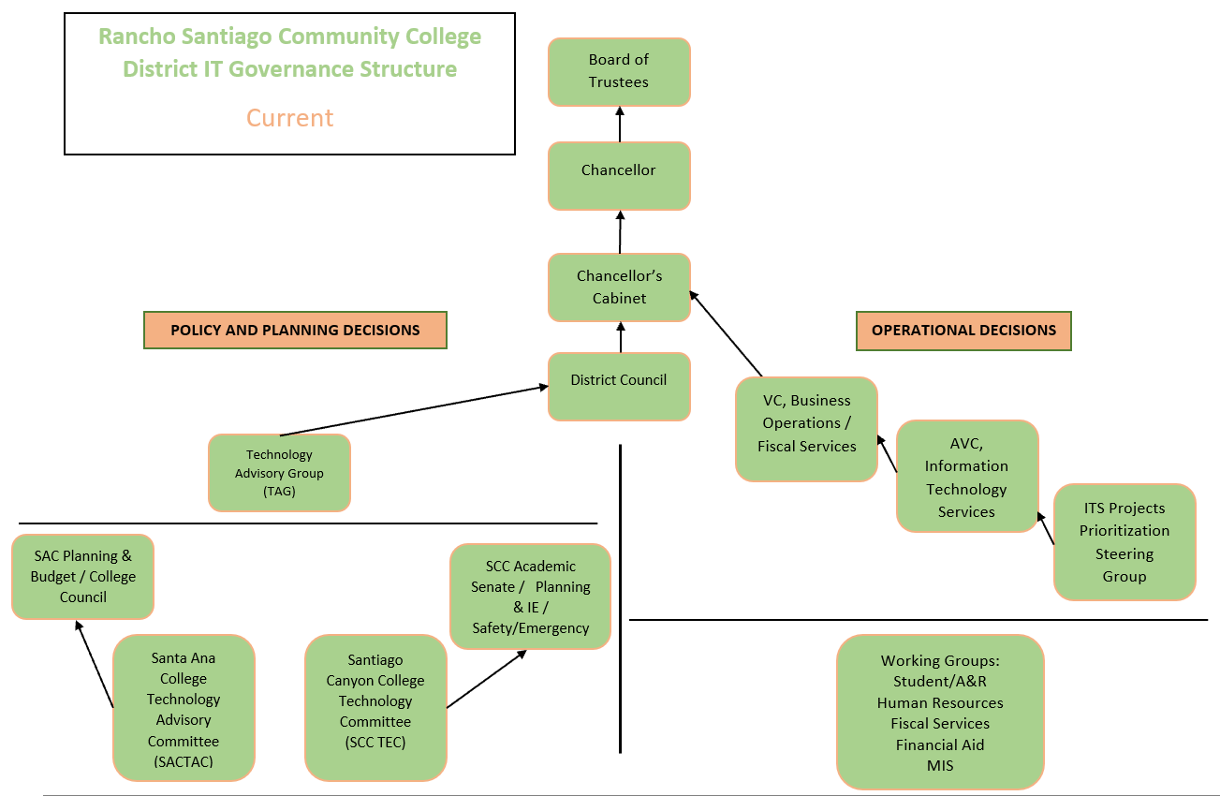
Current Structure
Notes:
Describe the Current Technology decision-making structure in detail. Left hand side you are familiar with. Right hand side has been happening behind the scenes to accomplish the work in an informal manner since the implementation of Colleague. Now we want to look at formalizing the structure to be more transparent and provide better communications.

Slide 12
Issues to Address –
Formal Flow of Information
Notes:
Point out the three areas of weakness in this current structure.
Lack of communication and coordination between the campus committees and the TAG
Lack of communication and coordination between the Working groups and ITS Project Prioritization Workgroup
No communication between the TAG and the Operational Groups except at the most senior levels

Slide 13
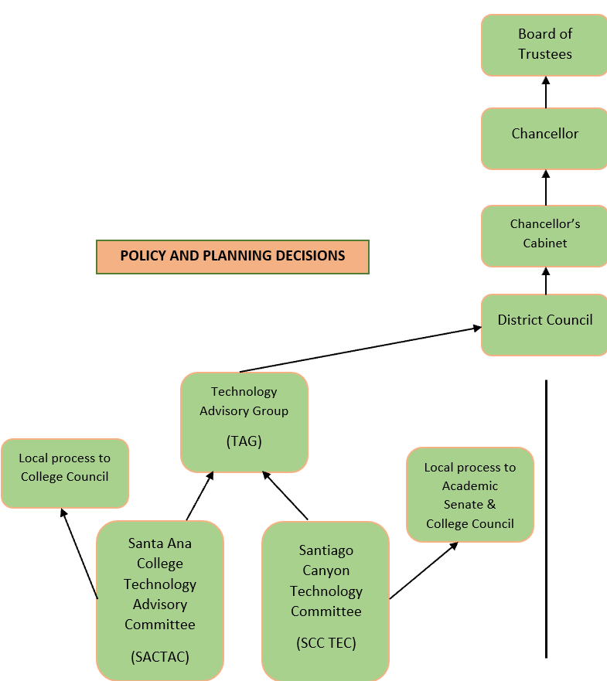
Proposed Policy and Planning Structure
Notes:
Recommendation for how to resolve the issue with TAG and SACTAC/SCCTEC

Slide 14
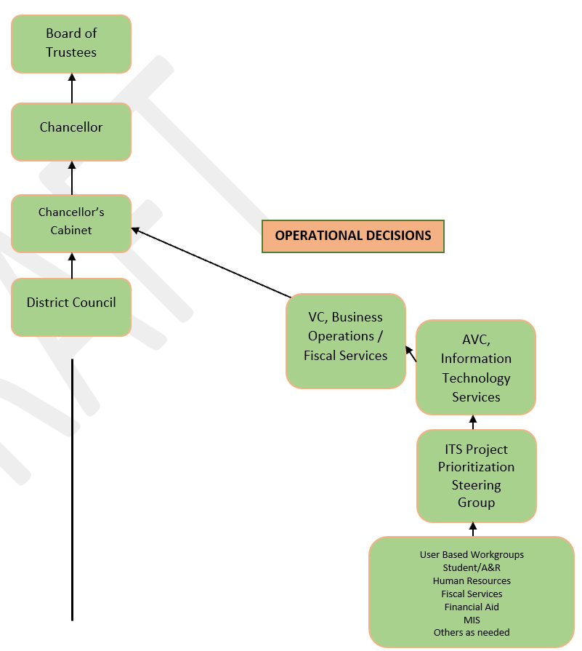
Proposed Operational Structure
Notes:
Recommendation for how to solve issue of communication between User Groups and this group

Slide 15
Role of this Governance Committee
Policy and Planning
  Develop and evaluate RSCCD and college technology plans
  Assess the effective use of technology resources
  Develop and evaluate hardware and software standards
  Review and evaluate hardware replacement cycle
  Develop recommendations regarding equipment, staffing, and training needs related to the use of technology
Sources:
  Website: https://rsccd.edu/Departments/Business-Operations/Pages/Technology-Advisory-Group.aspx​
  RSCCD Planning Design Manual: https://www.rsccd.edu/Departments/Educational-Services/POE-Committee/Documents/RSCCD-Planning-Design-Manual%202013.pdf#search=planning%20and%20design%20manual
Notes:
Role that this group should and can play in making technology decision making more effective and efficient. This is from your website and is clear that your responsibilities are policy and planning!

Slide 16
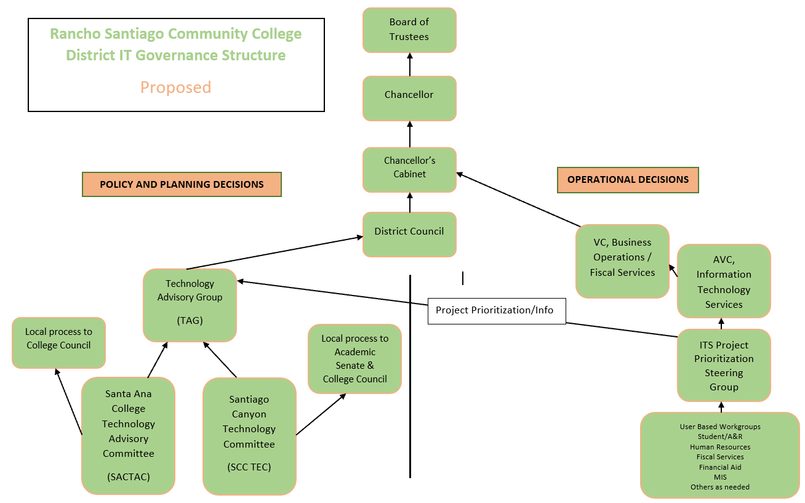
Bringing it All Together
Notes:
Share how Project Prioritization can be shared to develop buy-in and better implementation efforts. Also not that it is recommended that TAG and ITS Project Prioritization meet once a semester to hear presentations on accomplishments and share ideas at least initially. Much like the March 5th update.

Slide 17
Discussion & Questions
Notes:
Open it up for discussion, comments and next steps.

