Slide 1

Rancho Santiago Community College District
Strategic planning UPDATE
Dr. Adriene “Alex” Davis, Supported by College and District Researchers
Acting Vice Chancellor, Educational Services
September 12, 2022

Slide 2
PRESENTATION OVERVIEW
Our District Planning Process
What Have We Accomplished?
Where Are We Going?
How Will We Get There?

Slide 3

RSCCD PLANNING PROCESS
2013-2023
COMPREHENSIVE MASTER PLAN
Adopted May 2013
THREE STRATEGIC
PLANNING CYCLES
2013-2016 • 2016-2019 • 2019-2022
RSCCD Goals used to
DEVELOP OBJECTIVES
in RSCCD Strategic Plan
RSCCD Goals and Objectives aligned to COLLEGES’ GOALS

Slide 4
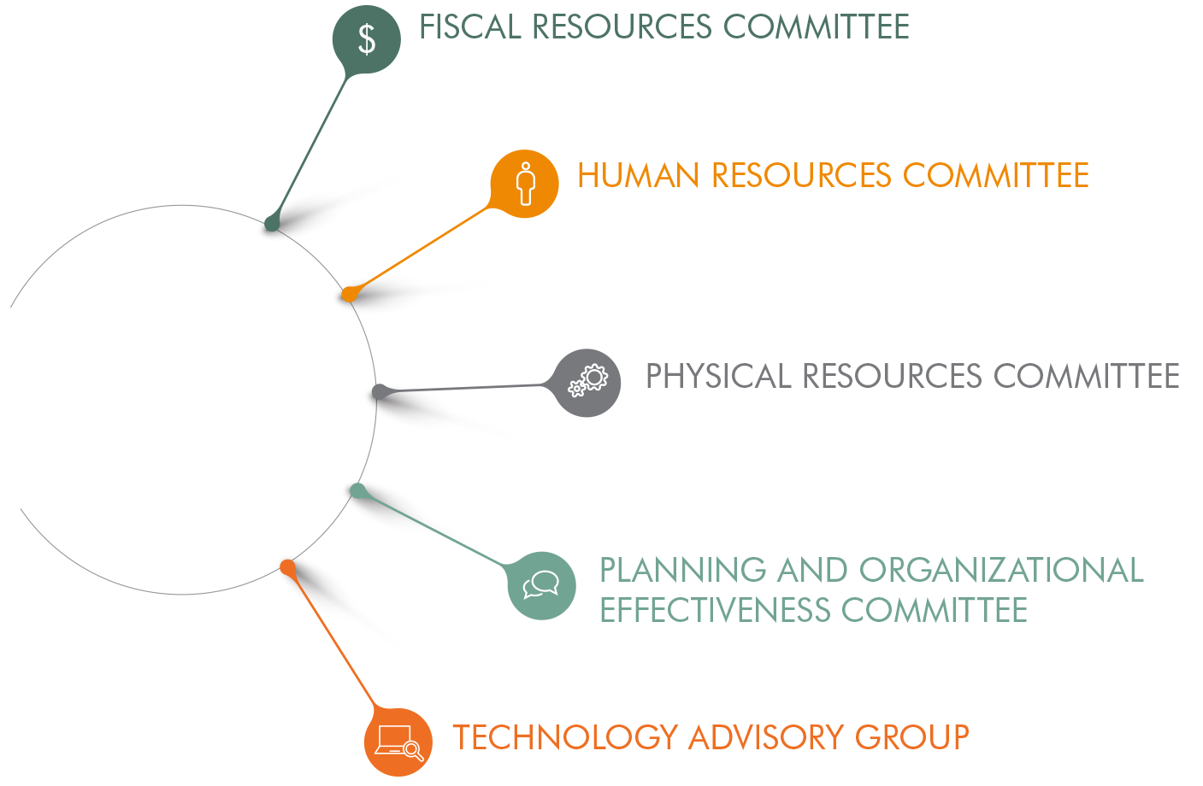
RSCCD PARTICIPATORY GOVERNANCE
DISTRICT COUNCIL

Slide 5
WHAT HAVE WE ACCOMPLISHED?

Slide 6
WHAT HAVE WE ACCOMPLISHED?
GOAL #1: RSCCD will assess the educational needs of the communities served by RSCCD and will adjust instructional programs, offerings, and support services and will allocate resources as needed to optimize the alignment of students’ needs with services and fiscal resources.
2019-2022 Objective 1A (Page 7)
Optimized the Numbers of Feeder High School Students Enrolled at SAC/SCC.
2019-2022 Objective 1B (Page 27)
Developed Sustainable, Alternative Revenue Streams to Address Student Educational Needs.
2019-2022 Objective 1C (Page 38)
Increased Outreach to Adults Seeking College Credit or Continuing Education Classes.

Slide 7
WHAT HAVE WE ACCOMPLISHED?
GOAL #2: RSCCD will assess the educational needs of the communities served by RSCCD and then pursue partnerships with educational institutions, public agencies, non-profit organizations, and business/industry/labor to collaboratively meet those needs.
2019-2022 Objective 2A (Page 49)
Maintained Effective Relationships and Fostered New Partnerships that Addressed Local Educational Needs.
2019-2022 Objective 2B (Page 57)
Supported Regional Collaboration that Addressed the Needs of Local Employers in High Demand Occupations.

Slide 8
WHAT HAVE WE ACCOMPLISHED?
GOAL #3: RSCCD will annually improve the rates of course completion and completion of requirements for transfer, degrees, certificates, and diplomas.
2019-2022 Objective 3A (Page 67)
Enhanced the Ability to Predict Student Instructional Needs in Order to Improve Program Completion.
2019-2022 Objective 3B (Page 71)
Provided Alignment of Course Offerings with Student Educational Plans.
2019-2022 Objective 3C (Page 76)
Utilized College Equity Plans to Reduce Disproportionate Impact on Student Success.

Slide 9
WHAT HAVE WE ACCOMPLISHED? (Cont’d)
GOAL #3: RSCCD will annually improve the rates of course completion and completion of requirements for transfer, degrees, certificates, and diplomas.
2019-2022 Objective 3D (Page 81)
Increased Support for Distance Education and Open Educational Resources (OER).
2019-2022 Objective 3E (Page 87)
Consolidated Outreach Efforts with Concentrated Focus on Completion (Course, Diploma/Certificate/Degree Attainment, Noncredit-to-Credit Transfers, and Transfers from SAC/SCC to Four-Year Universities).

Slide 10
WHAT HAVE WE ACCOMPLISHED?
GOAL #4: RSCCD will support innovations and initiatives that result in quantifiable improvement in student access, preparedness, and success.
2019-2022 Objective 4A (Page 92)
Maintained/Enhanced RSCCD’s Technological Infrastructure.
2019-2022 Objective 4B (Page 96)
Enhanced Opportunities that Enabled Students to Access College Classes and Services Prior to High School Graduation.
2019-2022 Objective 4C (Page 100)
Supported Innovative Pedagogies and Curriculum Design.

Slide 11
WHAT HAVE WE ACCOMPLISHED? (Cont’d)
GOAL #4: RSCCD will support innovations and initiatives that result in quantifiable improvement in student access, preparedness, and success.
2019-2022 Objective 4D (Page 111)
In Collaboration with Constituent Groups, Provided Support for Efforts to Increase Faculty/Staff Diversity.
2019-2022 Objective 4E (Page 116)
Deployed, Maintained, and Enhanced RSCCD’s Software Platforms that Support Student Learning.

Slide 12
WHAT HAVE WE ACCOMPLISHED?
GOAL #5: RSCCD will use a cycle of integrated planning that will demonstrate the effective use of resources.
2019-2022 Objective 5A (Page 119)
Supported and Encouraged Green Practices and Sustainability.
2019-2022 Objective 5B (Page 128)
Refined and Improved the Synchrony of Integrated Planning and Resource Allocation Processes Between the Colleges and District.
2019-2022 Objective 5C (Page 132)
Evaluated and Improved the Cycle of Integrated Planning.

Slide 13
Where are we going?

Slide 14
WHERE ARE WE GOING?
Large College FTES ≥ 20,000
Medium College 10,000 ≥ FTES < 20,000
Small College FTES < 10,000

Slide 15
RSCCD TOTAL APPORTIONMENT FTES
Actuals
2017-18 2018-19 2019-20 2020-21 2021-22
Targets
2022-23 2023-24 2024-25
FTES Diff (%)
24,754**
Sources: RSCCD FTES Summarized 320 Report; Targets Provided by Vice Presidents of Academic Affairs
*2021-22 FTES based on estimates
Notes:
2020-21 FTES projected at P1

Slide 16
SAC TOTAL APPORTIONMENT FTES
Actuals
2017-18 2018-19 2019-20 2020-21
Targets
2021-22 2022-23 2023-24 2024-25
-11.83% 2.74% -8.19% -0.60% 6.31% 5.67% 4.99%
FTES Diff (%)
(102)
Sources: RSCCD FTES Summarized 320 Report; Targets Provided by Vice President of Academic Affairs
*2021-22 FTES based on estimates
Notes:
2020-21 FTES projected at P1
1,500 in SAC’s decline was due to a loss of Fire and Police academies, Advanced Officer Training, and Instructional Service Agreements

Slide 17
SCC TOTAL APPORTIONMENT FTES
Actuals
Targets
2021-22 2022-23 2023-24 2024-25
FTES Diff (%)
Sources: RSCCD FTES Summarized 320 Report; Targets Provided by Vice President of Academic Affairs
*2021-22 FTES based on estimates

Slide 18
How will we get there?

Slide 19
RSCCD COMPREHESIVE MASTER PLAN
10-YEAR COMPREHENSIVE MASTER PLAN
2013-2016 • 2016-2019 • 2019-2022
7-YEAR COMPREHENSIVE MASTER PLAN
2023-2026 • 2026-2029
To align with new 7-year accreditation cycle
To align with colleges’ educational master plan
More flexibility to adjust to our changing environment

Slide 20
2022-2023 PLANNING ACTIVITIES
DO
Align & Integrate District Comprehensive Master Plan to Colleges’ Education Master Plan
Environmental scan (internal & external assessment)
Create 2023-30 Comprehensive Master Plan
Create 2023-26 RSCCD Strategic Plan
Create/Assess Colleges’ Educational Master Plan
SAC
SCC

Slide 21
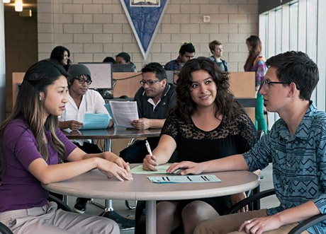
GOAL #1
Santa Ana College Goals
Provide support services that remove barriers for timely completion of educational goals of students.
Provide Career and Academic Pathways (CAPs) to all students together with academic and student support services they need to complete their educational goals in a timely manner.
RSCCD will assess the educational needs of the communities served by RSCCD and will adjust instructional programs, offerings, and support services and will allocate resources as needed to optimize the alignment of students’ needs with services and fiscal resources.
Santiago Canyon College Goals
Support a college culture of academic excellence and personalized education.
Support student success and equity by enhancing the integration of student services, instructional areas, and institutional initiatives.
Focus on student completions of pathways.
Improve communication within the college community.
Support faculty and staff development.
Maintain and enhance the college’s technological infrastructure and facilities.
Enhance and expand the college’s community presence.
Notes:
LA/OC Regional Consortium provided leadership in planning the K-12 SWP initiative, developed partnership/collaboration with OCDE, COE provided current labor market data to assess academic programs
RSAEC implemented strategies to increase completion, integrated educational opportunities for students in basic skills and career education, offered flexible learning options to ease enrollment from NC to CR

Slide 22
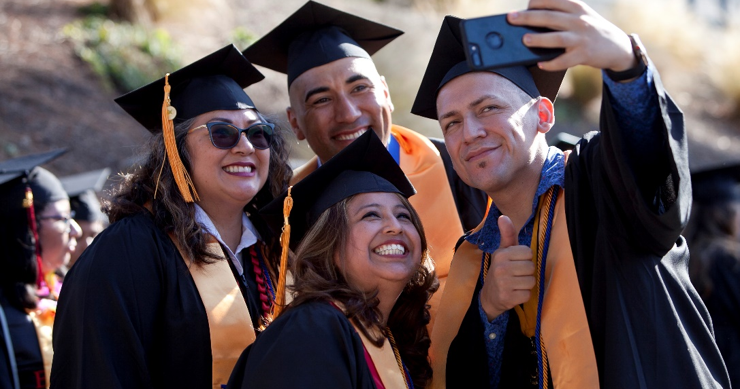
GOAL #2
Santa Ana College Goals
Prepare students for successful, livable-wage employment closely related to their field of study.
Develop a comprehensive career education marketing, outreach, and recruitment plan.
Develop and offer innovative, high quality, workforce-ready, industry-driven career and technical programs.
RSCCD will assess the educational needs of the communities served by RSCCD and then pursue partnerships with educational institutions, public agencies, non-profit organizations, and business/industry/labor to collaboratively meet those needs.
Santiago Canyon College Goals
Will focus on student completion of pathways.
Will enhance and expand the college’s community presence.
Notes:
LA/OCRC partnered with local workforce Development Boards, OC Business Council to generate programs addressing employment & business needs
LAOCRC and being fiscal agent has given District much visibility and many partnerships.
The Colleges strengthened partnerships with local USDs and nearby community colleges, CSUs & UCs to outreach and create educational access and pathways; with grassroot communities for outreach to colleges’ programs; and with businesses to create scholarships and financial opportunities for students

Slide 23
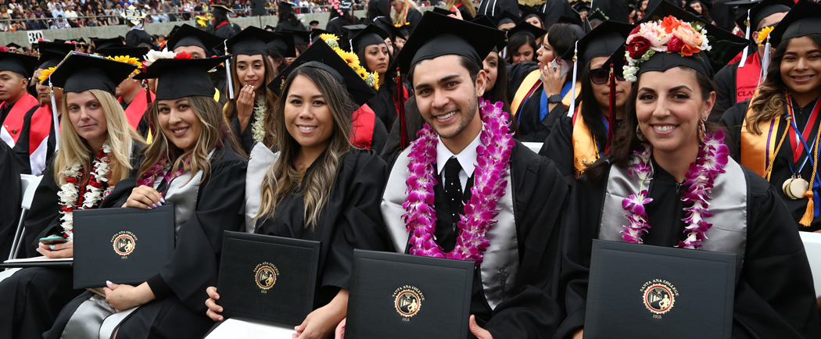
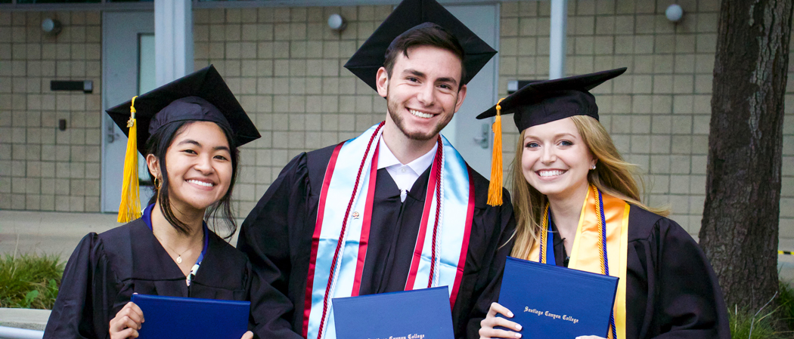
GOAL #3
SAC Goals
SG3. SAC will increase the number of students transferring annually to 4-year institutions.
SG4. SAC will provide services that support student integration into college life, student retention and persistence, and the accumulation of fewer units that will result in the efficient achievement of a chosen educational goal by 50% of our students within 5 years.
RSCCD will annually improve the rates of course completion and completion of requirements for transfer, degrees, certificates, and diplomas.
SCC Goals
II. SCC will support student success and equity by enhancing the integration of student services, instructional areas, and institutional initiatives
III. SCC will focus on student completion of pathways
Notes:
District engaged in data governance review of all data processes, from data entry, to submission of data, to usage of data, and data output
Creation of data reports and visual dashboards that allow users to compare data (at course, department, division and overall college levels) at any given time to past semesters
Survey students regularly to understand their opinions at various points of educational journey, as well as at times that may impact their education (such as during transition to fully online classes during COVID-19)
Revamped District Enrollment Management Workgroup to review and address enrollment issues across the district

Slide 24
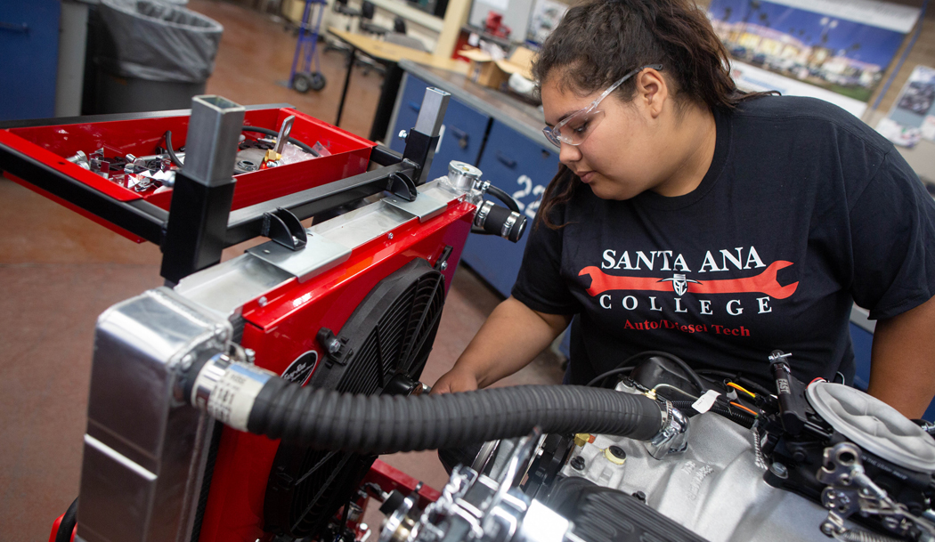
GOAL #4
Santa Ana College Goals
8. In order to reduce achievement gaps in all areas by 40% by 2022, SAC, within the context of its diverse community, will systematically equitize its practices leading to culturally responsive programs and services.
RSCCD will support innovations and initiatives that result in quantifiable improvement in student access, preparedness, and success.
Santiago Canyon College Goals
2. Will support student success and equity by enhancing the integration of student services, instructional areas, and institutional initiatives
3. Will focus on student completion of pathways
4. Will improve communication within the college community
5. Will support faculty and staff development
7. Will maintain and enhance the college's technological infrastructure and facilities
9. Will enhance and expand the college’s community presence
Notes:
Integrated districtwide and college-level Technology Advisory Committees to oversee technology needs
Limited funding impacts the number of upgrades/replacement media needs
Lengthy State Architects approval process to install projector upgrade and/or install in new facilities

Slide 25
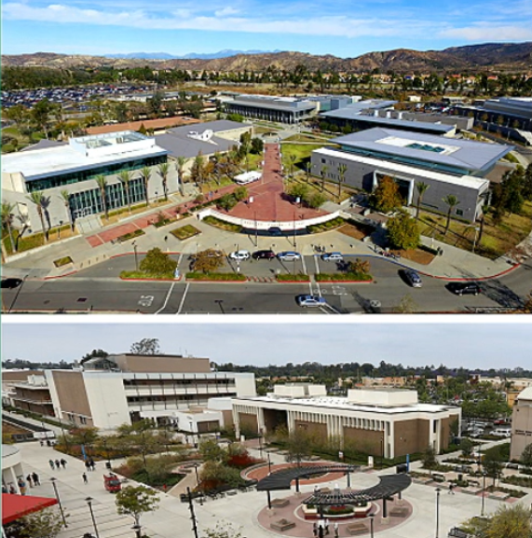
GOAL #5
Santa Ana College does not have any goals aligned to this RSCCD Goal
RSCCD will use a cycle of integrated planning that will demonstrate the effective use of resources.
Santiago Canyon College Goals
6. SCC will optimize access to physical, technological, human, and fiscal resources through data-informed, integrated planning and resource allocation processes
SCC will maintain and enhance the college's technological infrastructure and facilities
8. SCC will strengthen and refine the processes that integrate planning and resource allocation
Notes:
SAC uses EMS to control HVAC & lighting, new building constructions meet and/or exceed Title 24 green standards, and integrates student & curriculum development when feasible
SCC uses EMS to control HVAC & lighting, installed hydration stations and electric hand dryers, installed two electrical charging stations

Slide 26

QUESTIONS?

