Slide 1



Student Success Scorecard &
Other Institutional Effectiveness Metrics
September 25, 2017

Slide 2
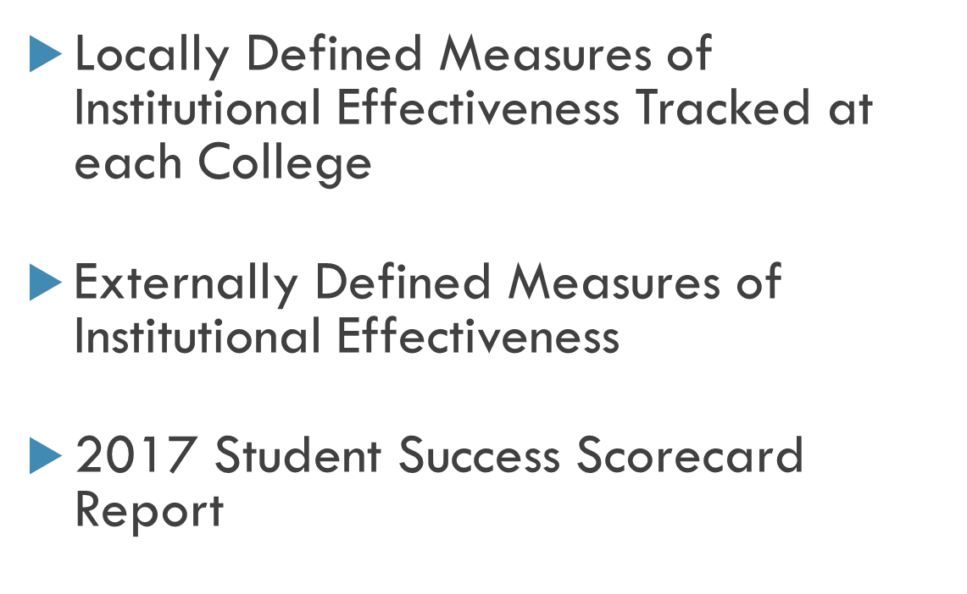
Today’s Agenda

Slide 3

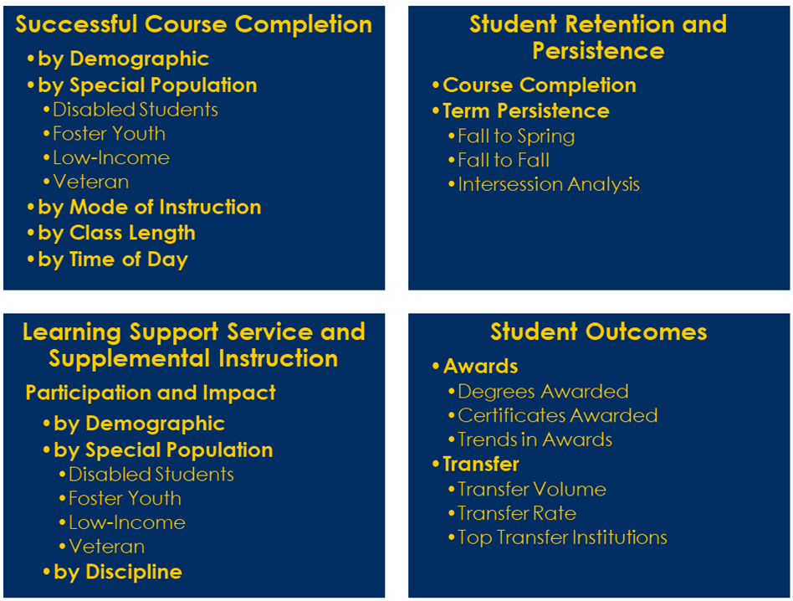


Slide 4

Successful Course Completion
Student Retention and Persistence
Special Initiatives
Participation and Impact
Student Academic Outcomes
by Demographic
by Time of Day
by Discipline
Course Completion
by Demographic/Special Pop.
Persistence
Fall to Spring
Fall to Fall
by Special Population
by Mode of Instruction
Disabled Students
Foster Youth
BOG Waiver Recipient
Two-year Persistence
Veteran
Pell Grant Recipient
by Math/English sequence
Units Accumulated / GPA
Awards
Degrees Awarded
Certificates Awarded
Time-to-degree
Transfer
Transfer Volume
Top Transfer Institutions
Transfer Ready Status

Slide 5

Accountability
ACCJC Annual Report Data
Institution-Set Standards
IEPI Goal Framework
Student Success Scorecard
Student Equity Success Indicators

Slide 6
Student Success Scorecard:
Background
In 2004, Assembly Bill 1417 triggered the creation of a performance measurement system for the California Community Colleges
Legislation authorized the California Community Colleges Chancellor’s Office to design and implement a performance measurement system

Slide 7
Background
Outcomes are for the system as a whole and for individual colleges
Not designed to rank colleges but to provide a consistent set of data for colleges to evaluate their own progress over time
The scorecard shows how colleges perform on metrics designed to identify achievement gaps in three primary areas of the community college mission: basic skills, career technical education, and transfer

Slide 8
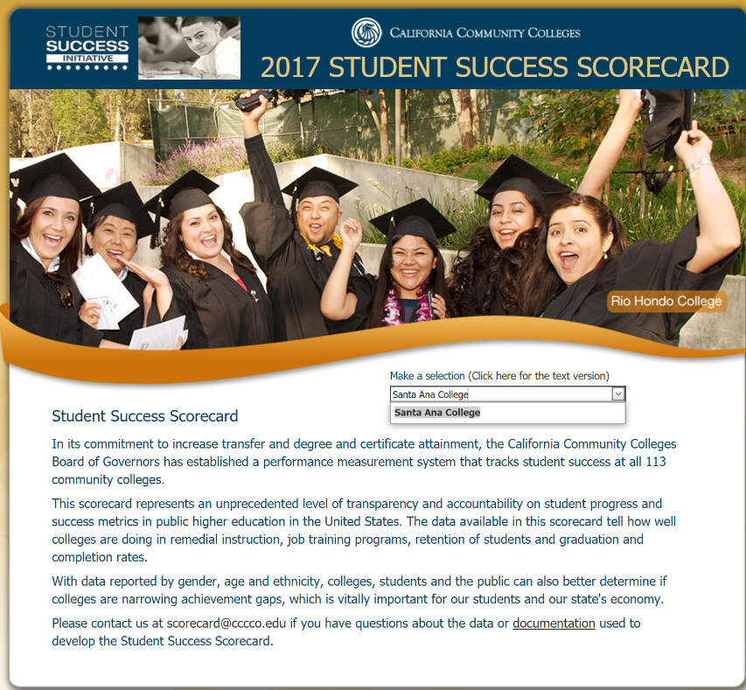
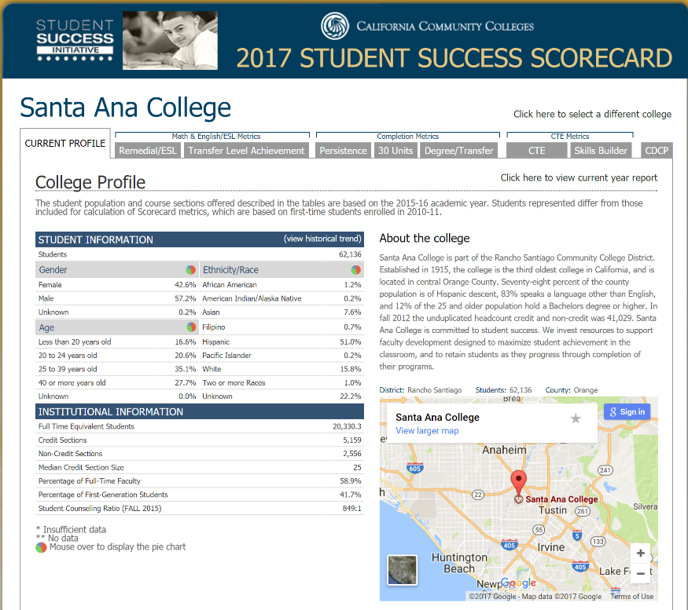
Background
Focus: making accountability data more readily available to the public

Slide 9
Institutional Profile
Description of College
Student Information
    Annual Unduplicated Headcount
    Gender, Age and Ethnicity of Students
Other Information
    Full-Time Equivalent Students (FTES)
    Course Sections (credit/non-credit)
    Median Credit Section Size
    Percentage of Full-Time Faculty (RSCCD Value)
    Percent of First Generation Students
    Student Counseling Ratio

Slide 10
Ethnic Distribution: 2015-2016

Slide 11
Institutional Profile Data: 2015-2016
 | SAC | State | SCC
Headcount | 62,136 | 2,355,825 | 26,734
Full-Time Equivalent Students | 20,330.3 | 1,137,618.7 | 8,571.3
Credit Sections | 5,159 | 346,360 | 2,271
Non-Credit Sections | 2,556 | 30,526 | 1,528
Median Credit Sec. Size | 25 | 26 | 29
Percent of Full-Time Faculty | 60.50% | 56.10% | 60.50%
Percent of First Generation Students | 41.70% | 42.40% | N/A
Student Counseling Ratio | 849:1 | 615:1 | 748:1

Slide 12
Student Groups
Overall – Student attempts any level of Math or English in the first three years
Prepared for College – Student’s lowest course attempt in Math and/or English is college level
Unprepared for College – Student’s lowest course attempt in Math and/or English is remedial level

Slide 13
Momentum Point: Remedial Progress
Cohort (denominator)
  Attempt a remedial course in English, Math, or ESL for the first time
Outcome (numerator)
  Complete a degree applicable or transfer level course within the same discipline within 6 years.

Slide 14
Momentum Point: Remedial Progress

Slide 15


Slide 16
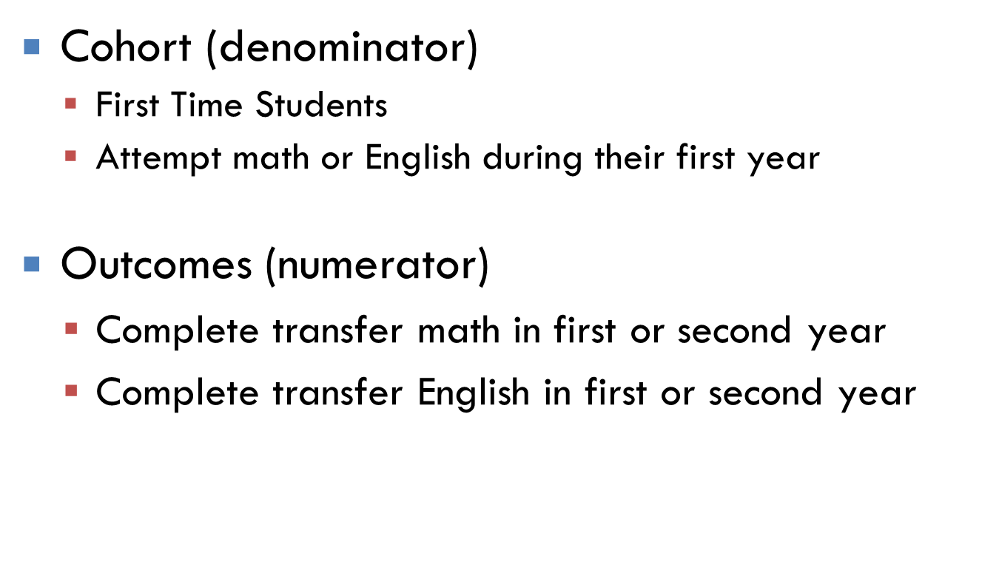
Momentum Point: Transfer Level

Slide 17

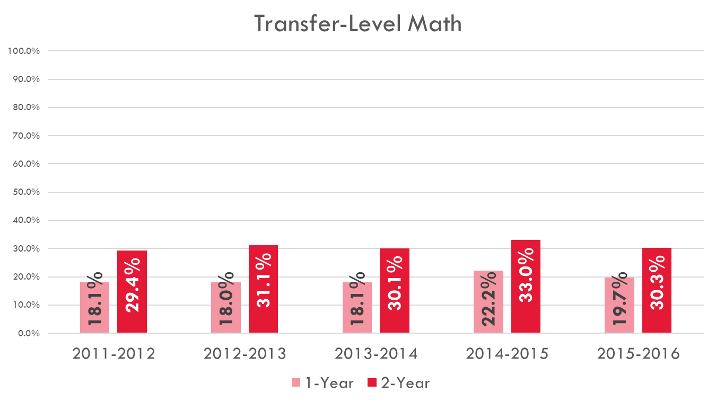

Slide 18

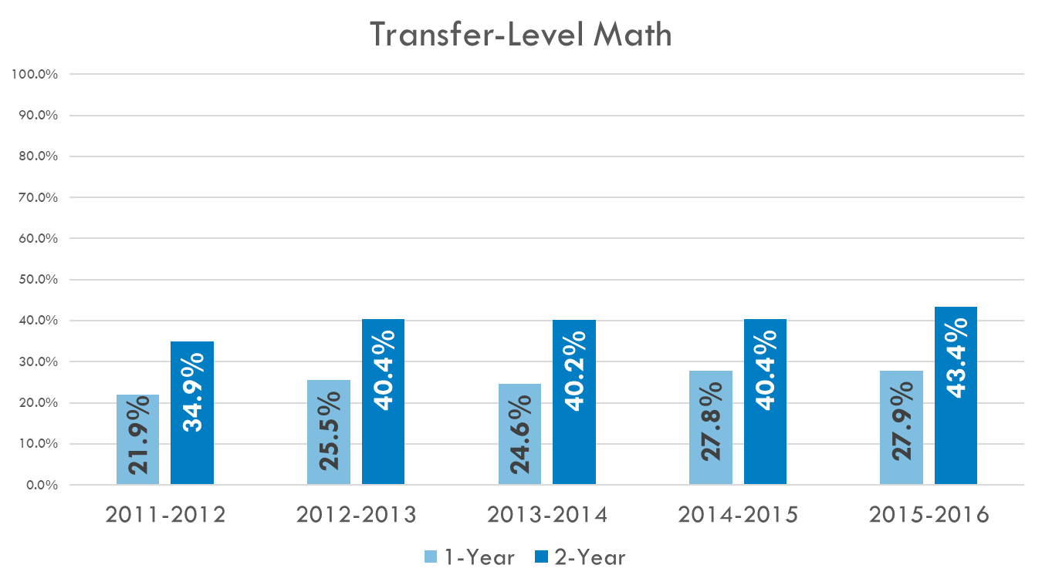

Slide 20


Slide 21
Momentum Point: Persistence
Cohort (denominator)
  First Time Students
  Complete 6 units and attempt any Math or English course within 3 years
Outcome (numerator)
  Enroll in three consecutive semesters
  Students who complete a degree or certificate or transfer to a four-year institution within three consecutive primary semesters are counted

Slide 22

Overall Statewide Average

Slide 23
Overall Statewide Average

Slide 24
Momentum Point: 30 Units
Cohort (denominator)
  First Time Students
  Complete 6 units and attempt any Math or English course within 3 years
Outcome (numerator)
  Complete at least 30 units within 6 years

Slide 25

Overall Statewide Average

Slide 26

Overall Statewide Average

Slide 27
Completion Outcome: Completion
Cohort (denominator)
  First Time Students
  Complete 6 units and attempt any Math or English within 3 years
Outcome (numerator) within 6 years
  Complete a Degree or Certificate of Achievement
  Transfer
  Achieve Transfer Prepared Status
    (60 transferable units, 2.0 GPA)

Slide 28

Overall Statewide Average

Slide 30
Overall Statewide Average

Slide 31


Slide 32
Completion Outcome: CDCP
Cohort (denominator)
  Attempt 2 or more CDCP courses, with a minimum of 4 attendance hours in each, within 3 years
  At least one course is Advanced Occupational or Clearly Occupational
Outcome (numerator) within 6 years
  Complete CDCP Certificate
  Complete Degree or Certificate of Achievement
  Transfer
  Achieve Transfer Prepared Status
    (60 transferable units, 2.0 GPA)

Slide 33

Overall Statewide Average

Slide 34
Overall Statewide Average

Slide 35
Completion Outcome: CTE Rate
Cohort (denominator)
  First time in a CTE course
  Complete more than 8 units in a single CTE discipline in 3 years
  At least one course is Advanced Occupational or Clearly Occupational
Outcome (numerator) within 6 years
  Complete a Degree or Certificate of Achievement
  Transfer
  Achieve Transfer Prepared Status
    (60 transferable units, 2.0 GPA)

Slide 36

Overall Statewide Average

Slide 37
Overall Statewide Average

Slide 38
CTE Metric: Skills Builder
Cohort
  At least .5 units in Apprenticeship, Advanced Occupational or Clearly Occupational course during academic year
  Must not fail any CTE coursework during that year
  Must not be enrolled anywhere in the system the following academic year and did not achieve a completion outcome the year of enrollment or the following year
Outcome
  Annual inflation-adjusted median percentage change in earnings (1 year before to 1 year after) for all students in the cohort

Slide 39
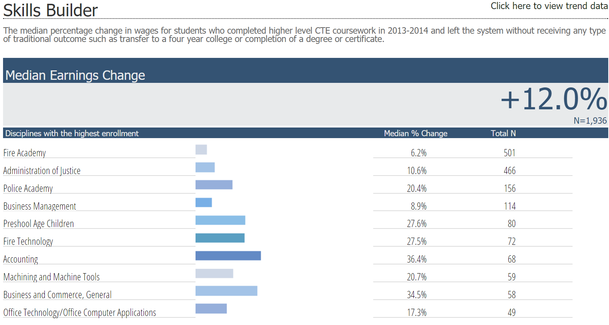
CTE Metric: Skills Builder
Santa Ana College

Slide 40
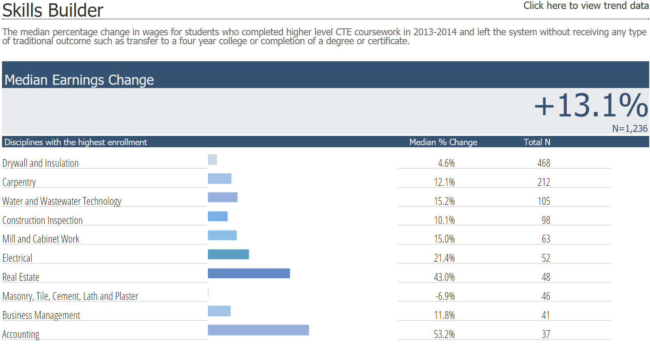
CTE Metric: Skills Builder
Santiago Canyon College

Slide 41
The Role of the Student Success Scorecard
at SAC and SCC
  Strengths
  Enables us to compare our college cohort data over time
  Provides easy access to statewide data and to comparable college data
  Limitations
  Students who do not have social security numbers are not included in the cohort data
  This is not a good source of information on year to year student success

