Slide 1
MetLife Group Benefits
Prepared for: Rancho Santiago Community College District
  Dental PPO
  MetLife Legal Plans
  Group Auto and Home
  Pet Insurance
ADF# MULTI1825.18

Slide 2
MetLife Dental PPO
ADF# MULTI1825.18

Slide 3




Dental PPO – What’s in it for you?
You can choose from a large network of carefully selected, pre-screened dentists
You’ll typically pay 30-45% less than the average charges in the same area¹
Usually your dentist handles claims – meaning less paperwork for you
You’ll have easy access to pre-treatment estimates, real-time claims processing and 24-hour
customer service

Slide 4
Dental PPO benefits breakdown
Services provided | In-network dentists: percentage of negotiated fee² | Out-of-network dentists: percentage of reasonable & customary (R&C)³
Type A: Preventive services | 100% | 100%
Type B: Basic services | 90% | 90%
Type C: Major services | 70% | 50%
Annual deductible | $0 individual/$0 family | $0 individual/$0 family
Annual benefits maximum (Applies only to Type B &C Services) | $2,000 per person | $2,000 per person
Dental Accident Benefit | 100% (separate $1,000 maximum per person, per calendar year) | 100% (separate $1,000 maximum per person, per calendar year)

Slide 5
Dental PPO Summary
Beginning January 1st, 2021 employees and dependents receiving any Type A/Preventative Dental work will not have those claims counted towards their annual maximum. This means more of your annual maximum should be available for any Type B&C services needed.
Annual Maximums refresh each year on January 1st
Please visit MetLife.com/dental to look up participating network providers. All employees would be selecting the “PDP Plus” network
The following two slides, showing the MetLife mobile app and MyBenefits website, will be available to all employees on January 1st. Both services allow you to electronically view your benefits, pull ID cards, view claims and annual maximum usage, etc.
MetLife does not require employees to have ID cards to receive Dental services. Please let your provider know that you are covered by MetLife Dental and they will pull up you and your dependents information based off your social security number.

Slide 6
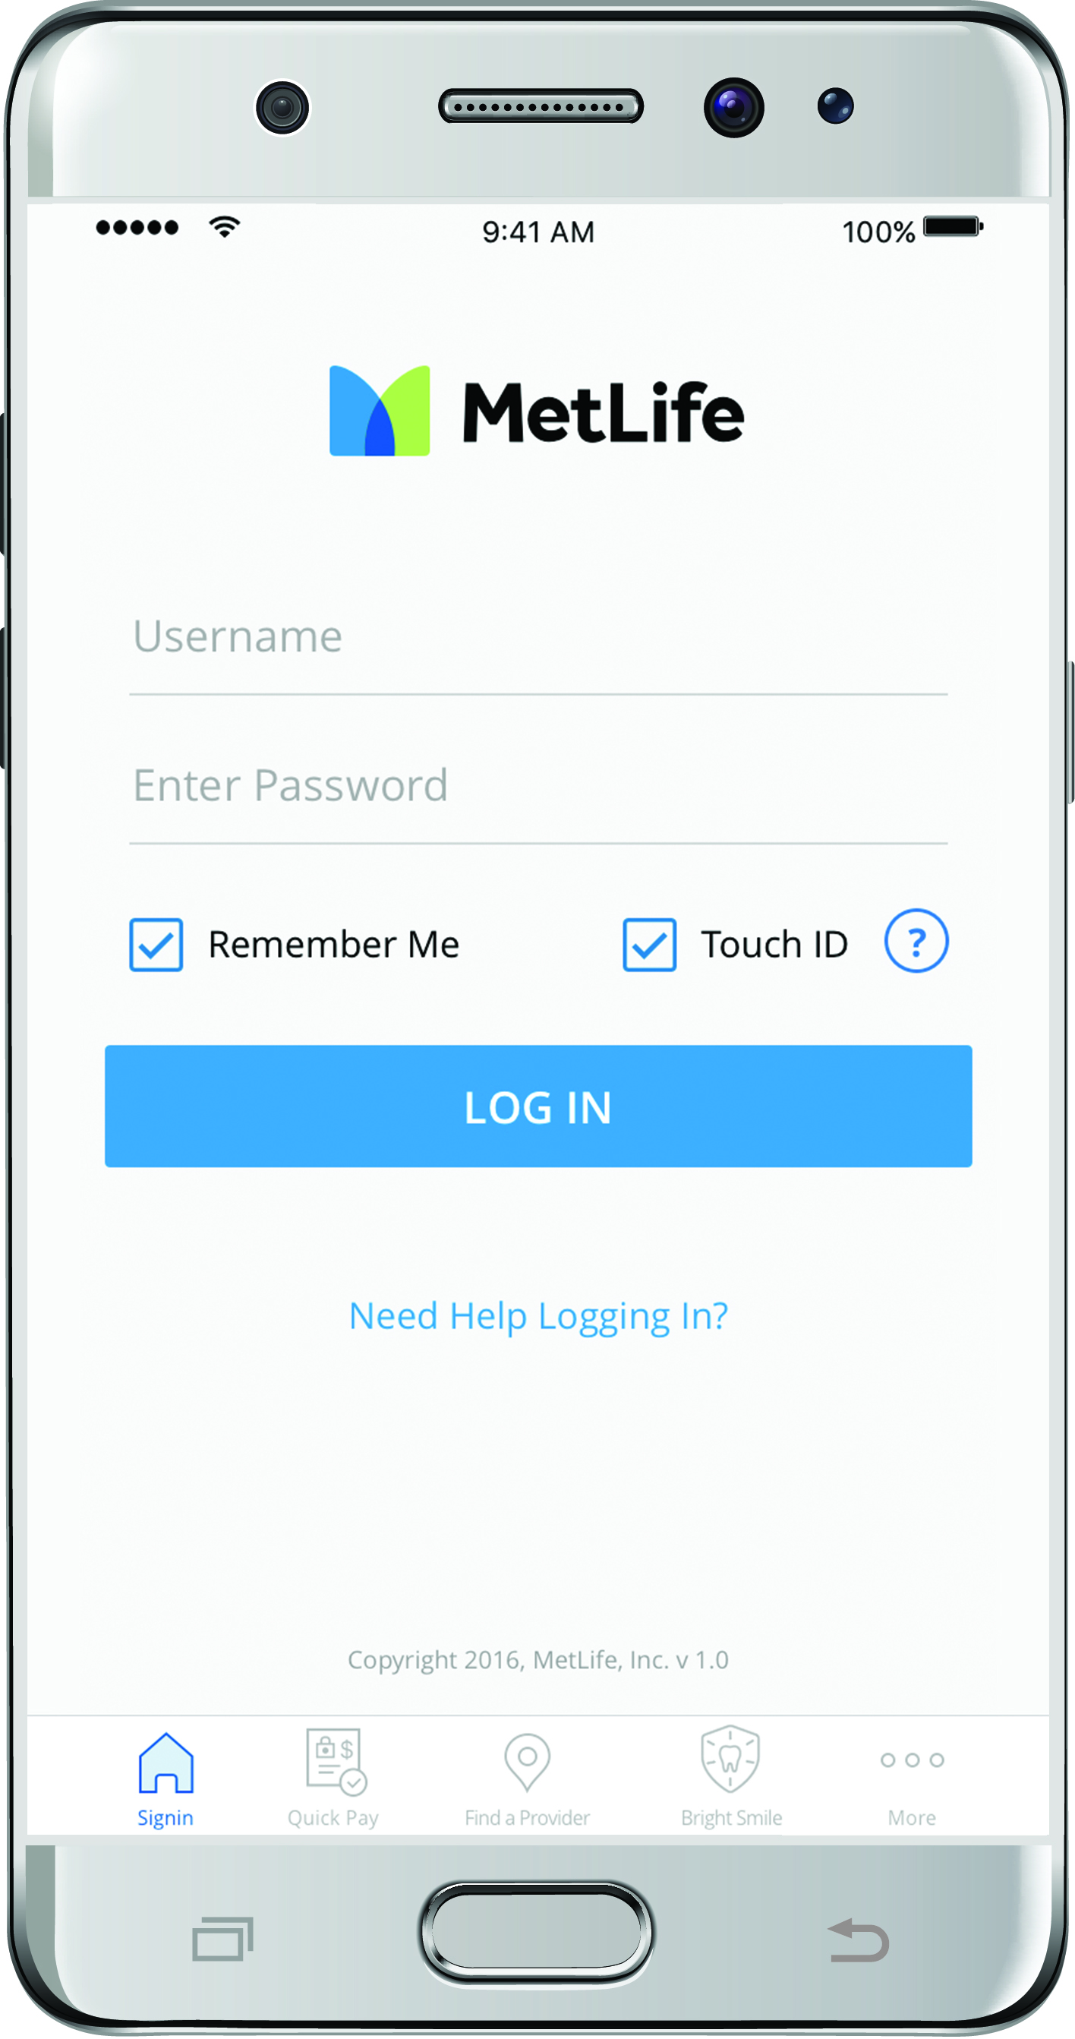
The MetLife mobile app
It’s easy. Download “MetLife US” at iTunes® App Store or Google Play.
Log in with your MyBenefits information to access these features.⁷
Dental⁷ | Find a dentist and get estimates on most procedures View your claims Access and print your electronic ID card Please note: ID cards are not required to obtain dental services.

Slide 7
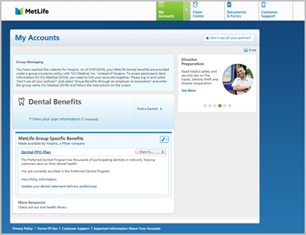
You can benefit from MyBenefits
MetLife Online Services capabilities may vary by product and may not be available to all customers.
www.metlife.com/mybenefits
With MyBenefits you can...
2
  View enrollment status
  Check recent claims and status
  Print ID cards
  Find essential forms
  Update profile information
  Designate beneficiaries
  Access educational tools
3
1
2
1
Customized product section with additional policy
contract and product details
Easy access to Forms, Customer Support and Claims Center
Add policies with the “Don’t see all your policies?” feature
2
3

Slide 8
Voluntary Benefits Available to You
ADF# MULTI1825.18

Slide 9

MetLife Legal services –
Key features
  No deductibles, claim forms,
  or copays
  No usage limits – full service on an unlimited number of some of the most common personal legal matters
  Access to experienced, credentialed network attorneys in person or by telephone
  Access to services in all 50 states, most U.S. territories, and worldwide
  Convenience of payroll deduction
Notes:
Navigating through some of life’s important moments like buying a home, creating a will, or defending a civil litigation matter can be overwhelming, especially if you can’t find an attorney that meets your needs or your budget. Now you can take advantage of [MetLife Legal Plans®/a legal services plan] to get convenient access to comprehensive legal services at an affordable cost, [$XX/month].
[The plan is easy to use – there are no deductibles, claim forms, or usage limits for covered services.]
[You will have access to a national network of more than 14,000 attorneys who meet our rigorous selection criteria, and there’s an out-of-network option available. The attorneys have on average of 25 years of experience (with a minimum of 8 years) and offer a broad array of legal services.]
[Simply call our client service center, and a representative will answer your questions and help you find a local attorney who best meets your needs. You may also access plan information, attorneys, documents and other valuable resources online at [info.legalplans.com].]

Slide 10







MetLife Legal services – Plan overview
Sample covered benefits
Money matters Identity theft Negotiating with creditors Tax audit representation | Family and personal Adoption Prenuptial agreement Personal property issues | Vehicle and driving Defense of traffic tickets⁶⁷ License suspension Repossession
Home and real estate Sale, purchase, or refinancing of a primary or vacation home Property tax assessment Foreclosure | Civil lawsuits Civil litigation defense Small claims assistance Pet liabilities
Estate planning documents Simple or complex wills Living wills Revocable or irrevocable trusts | Elder care issues⁶⁵ Medicare Nursing home agreements Powers of attorney
Employees without access
to a legal plan
can easily spend an average of $338 an hour for legal counsel.⁶⁶
Notes:
With our legal services, you get the attorney you need at a cost that’s very affordable, with access by telephone or in-person for expert advice on an unlimited number of covered personal legal matters, and representation for a wide variety of legal services, including:
[Estate planning documents, including wills and trusts]
[Real estate matters]
[Identity theft defense]
[Financial matters, such as debt-collection defense]
[Traffic offenses]
[Document review]
[Family law, including adoption and name change]
[Advice and consultation on personal legal matters]

Slide 11
MetLife Pet Insurance - Key Features
  Pet Insurance offered by MetLife¹ offers straightforward pricing, group discounts², customizable limits, deductible savings³, and a hassle-free claims process.
No breed exclusions
No upper age limits
No initial exam or previous vet records needed to enroll⁴
No per-incident or lifetime limits
  Group discounts² and deductible savings³
  Among the shortest wait periods⁵ with most claims processed within 10 days⁶
  Multichannel support options with caring, knowledgeable representatives
  Trusted benefits partner with more than 100+ years of experience
¹PetFirst Healthcare, LLC, a MetLife company, is the program administrator authorized to offer and administer pet health insurance policies underwritten by Independence American Insurance Company, a Delaware insurance company, with its main office at 485 Madison Avenue, NY, NY 10022. For costs, complete details of coverage, and a listing of approved states, please contact PetFirst Healthcare, LLC. Like most insurance policies, insurance policies offered by PetFirst Healthcare, LLC and underwritten by Independence American Insurance Company, contain certain exclusions, exceptions, reductions, limitations, and terms for keeping them in force
²This discount is not available in Tennessee. This discount is only available for individuals who purchase a policy through an employer group (10% for Groups > 1000 lives and 5% for Groups 50-999 lives).
³With deductible savings, your pet's deductible automatically decreases by $25 each policy year that you don't receive a claim reimbursement. May not be available in all states.
⁴Application is subject to review and approval by MetLife based upon its underwriting rules.
⁵ Accident coverage is midnight EST as of the day of enrollment compared to wait time of 2 to 15 days for many competitors; Illness coverage begins 14 days from the day of enrollment compared to 14 to 30 days for many competitors.
⁶80% of claims are processed within 10 days or less.

Slide 12

What does it cover¹?
  Accidental injuries
  illnesses
  exam fees
  surgeries
  medications
  ultrasounds
  hospital stays
  x-rays and
  diagnostic tests
  And our coverage¹
  also includes
  hip dysplasia
  hereditary conditions
  congenital conditions
  chronic conditions
  alternative therapies
  holistic care
  and much more!
  Pre-existing conditions may not be covered, so don’t wait. Insure your pet today.
¹Provided all terms of the policy are met. Like most insurance policies, insurance policies offered by PetFirst Healthcare, LLC and underwritten by Independence American Insurance Company, contain certain exclusions, exceptions, reductions, limitations, and terms for keeping them in force.

Slide 13

Additional Plan Features
Wellness Care Rider¹
  Want additional coverage² for routine exams, vaccinations and prescription medications? You can add a wellness care rider to your plan for these expenses. Coverage includes:
    Annual vet exams
    Routine tests or screens
    Vaccines
    Teeth cleaning or
    polishing
    Microchipping
    Preventative treatment
    for parasites such as fleas and heartworms
    Spay and neutering
    Behavior training
  Family Plan
MetLife also provides the unique feature of a Family Plan³. In a Family Plan, a policyholder is able to enroll up to three pets onto the same policy such that they share the same annual limits and coverage on the single policy. This feature is limited to pets under the age of 10 and allows policyholders more flexibility when considering enrolling multiple pets.
¹Can be purchased at an additional cost.
²Provided all terms of the policy are met. Like most insurance policies, insurance policies offered by PetFirst Healthcare, LLC and underwritten by Independence American Insurance Company, contain certain exclusions, exceptions, reductions, limitations, and terms for keeping them in force..
³A multi-policy discount is not available when enrolling into a Family Plan.

Slide 14



Enroll today!
Enroll during your annual open enrollment window
Visit your Human Resources Department for more details
Call
1-800-GET-MET8 (1-800-438-6388)
Monday through Friday, 8 am – 8 pm, EST

Slide 15
Thank you.

